Slide 1
HOW TO USE THIS DECK:
This deck should be customized to reflect your institution’s needs and setup within Faculty Accomplishments Reviews, Promotion and Tenure.
You can use this deck for basic Reviews, Promotion and Tenure (RPT) training with admins and instructors.
These slides are NOT meant to be all-inclusive of your training with your Product Consultant during your RPT implementation. Rather, this deck is designed to teach instructors and admins the skills they need as end users.
IMPORTANT:
Before using this deck as a base for training your instructors and admins, YOU MUST EDIT some of these slides for specific screenshots (for example, slide 8).
You will also want to provide a link to or handout of the Essential Skills checklist.
During your presentation, you may find it helpful to demonstrate tasks in Faculty Success live.

Slide 2
Faculty Accomplishments Reviews, Promotion and Tenure Faculty & Staff Essential Skills Training

Slide 3
Agenda
Introductions
Product Introduction
Campus Goals and Expectations
Essential Skills and Best Practices
Next Steps and Q&A

Slide 4
How do we see the bigger picture?
How do we move…
From This...
...To This
Paper-based, out-of-date
Complex processes
Faculty data silos
Home-grown tools
Lack of security and integrity
Eliminate manual tasks
Provide consistency and convenience
Easily track progress and provide guidance
Completion of critical campus processes—from one location
Intuitive, easy-to-use solutions that support processes

Slide 5
Faculty Accomplishments Reviews, Promotion and Tenure by Watermark
Reviews, Promotion and Tenure (RPT) is used with Faculty Accomplishments to fully digitize your processes for annual review and promotion & tenure and get rid of the binders filling your provost’s office. You can easily configure workflows with flexible steps and set up deadlines and notifications to ensure that faculty reviews are always secure, on time, and error-free.
RPT empowers you to track progress and provide guidance to your stakeholders to ensure completion of critical campus processes from one central location.

Slide 6
Campus Goals and Expectations

Slide 7
Future Faculty Accomplishments Reviews, Promotion and Tenure Campus Vision
Faculty Involved in Workflow Launch | Status | Projected Timeline
Spring 2023 – Business department pilot | Will launch February 6th, 2023
Fall 2023 – All departments | Will launch September 20, 2023
Notes:
Please insert a slide with your campus goals if you would like to explicitly outline your goals with your End Users.

Slide 8
Campus Expectations of Faculty
INSERT YOUR CAMPUS EXPECTATIONS HERE
Example:
Faculty are expected to log into Faculty Accomplishments Reviews, Promotion and Tenure using the URL provided or via the email they received to submit their Annual Review prior to xx/xx/xxxx.
Notes:
Please provide your expectations for your End Users. We’ve provided a few examples for you.

Slide 9
Essential Skills and Best Practices
Notes:
CSM Leads

Slide 10
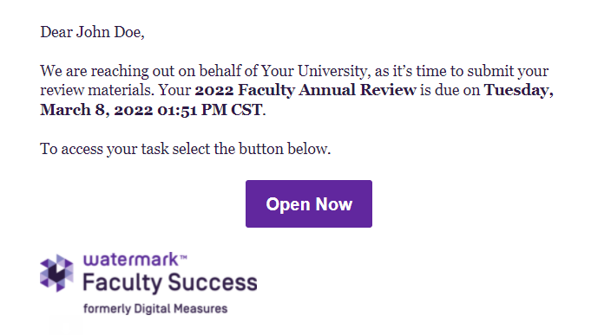
Accessing Reviews, Promotion and Tenure
When the Workflow process launches, tasks are created and await the attention of the faculty subjects who will submit their materials in the system. Faculty can access these tasks two ways:
Through the email that was generated when the process launched. The template controls whether this email notification is sent.
By logging into Faculty Success directly. When a process launches, the appropriate users will be given access to the Reviews, Promotion and Tenure Tasks utility, where they can review the Inbox for any available tasks.

Slide 11
Logging into Faculty Success is easy!
NOTE TO SYSTEM ADMIN:
PLACE SCREENSHOT OF YOUR Single Sign-On View / URL Landing Page for FACULTY & STAFF HERE.
NOTE: If you want to show your local login screen and URL, you can also include that here.

Slide 12
Tips and Reminders for Logging In
If Single Sign-On (SSO) is enabled for Faculty Success:
Use the SSO link provided by Watermark.
ADMIN - Add additional instructions here to clarify where link is located.
Access Reviews, Promotion and Tenure through the email that was automatically sent to the user.

Slide 13
Reviews, Promotion and Tenure Forms
The submission forms available to subjects are customized for each specific process and step by the Reviews, Promotion and Tenure (RPT) Administrator. Certain fields may be set as required. This is a configuration choice made when the form was created. Based on the type of fields selected, users may also have rich text formatting options that allow them to organize and emphasize their information as needed.
The process may also have been configured to automatically include a custom report from Faculty Success, populated with data from the Manage Activities utility. This report is generated when the process launches. Faculty have the ability to preview the report. If they notice any issues in the report or realize that additional activities need to be entered into the database, they can:
1. Save a draft of their progress on the RPT Task by accessing the Actions menu in the top right and selecting Save Draft. 2. Navigate to Manage Activities. 3. Correct or revise the appropriate data. 4. Return to the Workflow task and refresh the report, so the updates are reflected in the report.

Slide 14
Submitting a Step
Once a subject’s submission is complete and ready for review, they can simply click the Submit option on the Actions menu to move the materials to the next step in the process. At this point, the submission materials are locked (including any reports that have been attached), even if changes are made through the Manage Activities module.

Slide 15
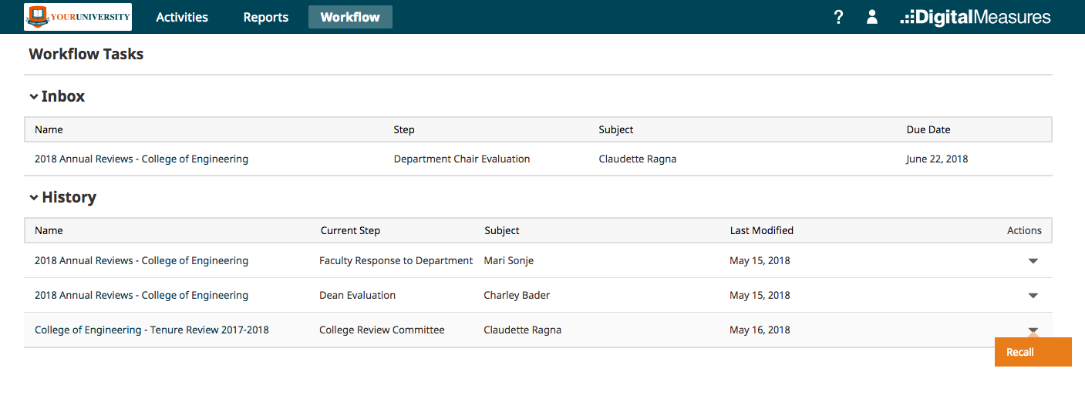
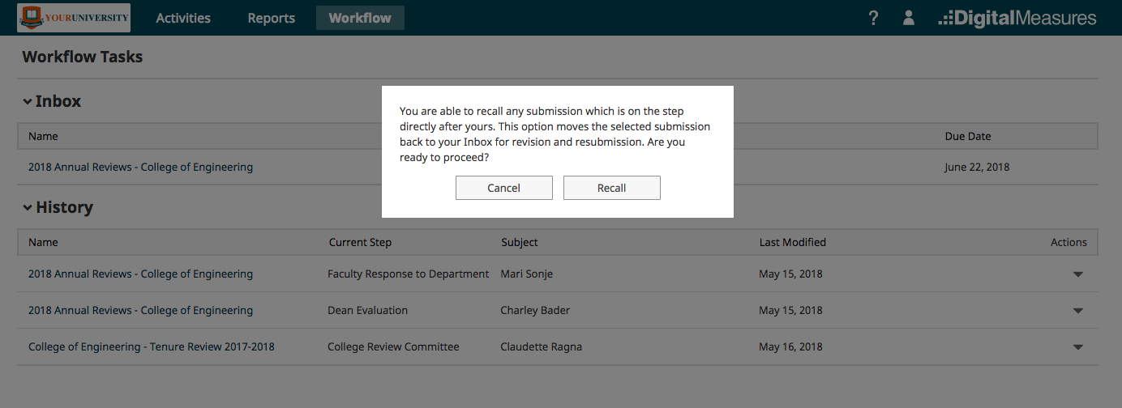
Recalling a Step
If you advance a submission to the next step, you can recall the submission from that step to:
Correct factual or typographical errors
Add a critical piece of information that was missed
Further review a submission that was prematurely advanced
Click the arrow under Actions.
Click Recall.
Note: Once the next step has begun, the recall option is no longer available.

Slide 16
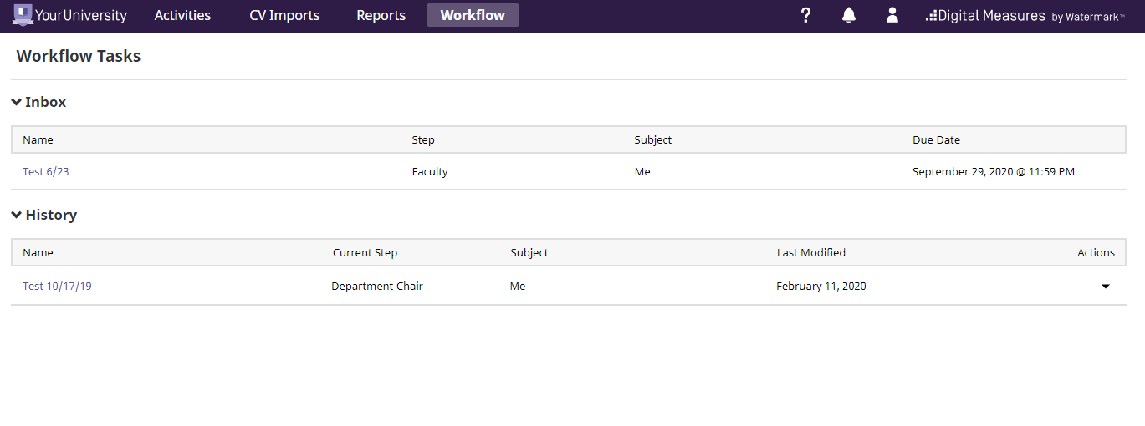
Accessing History
After a subject has advanced the process to the next step, they will see the task move from the Inbox to the History section in RPT. There, they can see where in the process the submission stands as it advances through each future step, and, depending on the form visibility settings, review the content of the submission and the fields completed by reviewers.
The historical record will remain available to the subject for future reference.
To access history:
Log into Faculty Success.
Click Workflow.
Locate the History section.

Slide 17
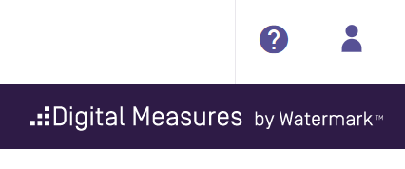
Help Tools
Click ? in the top right corner of your account to contact Technical Support or your campus administrator.

